Slide 1
Operational Amplifier: Comparator Application

Slide 2
Outline
Op-Amp: Comparator (Recap)
Comparator Application - Smoke Detectors
Smoke Detector – Operation
Comparator Application – Automatic AC
General Principle - Comparator

Slide 3
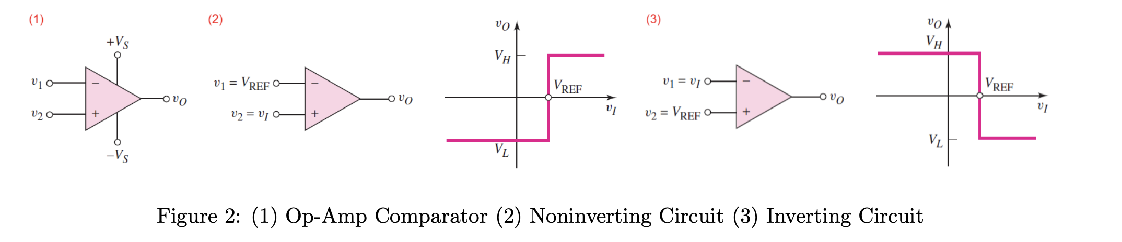


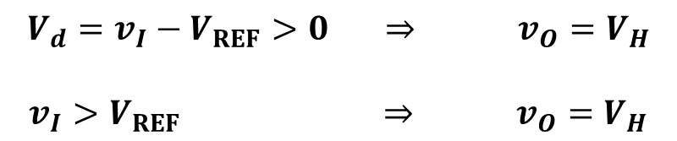
Op-Amp: Comparator (Recap)
Level Crossing Detector / Comparator
NON-INVERTING COMPARATOR

Slide 4


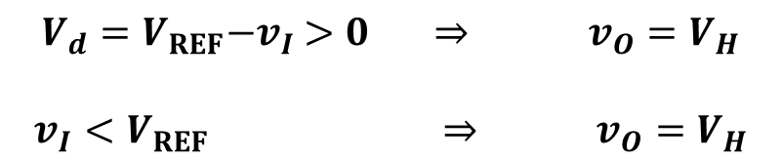
Op-Amp: Comparator (Recap)
Level Crossing Detector / Comparator
INVERTING COMPARATOR

Slide 5
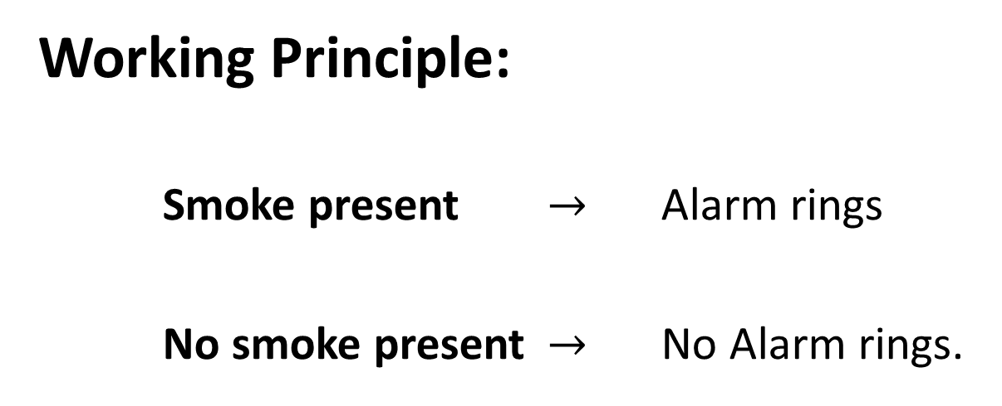


Comparator Application - Smoke Detectors
Since the alarm is an electrically driven device, we need some method to convert smoke levels to proportionate voltage.

Slide 6
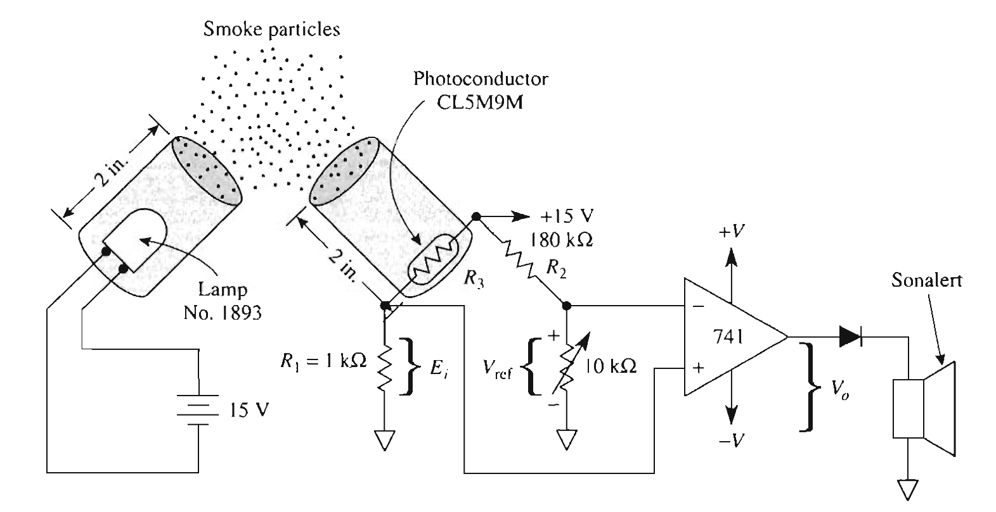
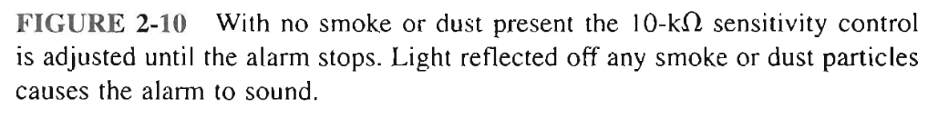
Comparator Application - Smoke Detectors
LED Circuit
Voltage Divider
Op-Amp comparator

Slide 7

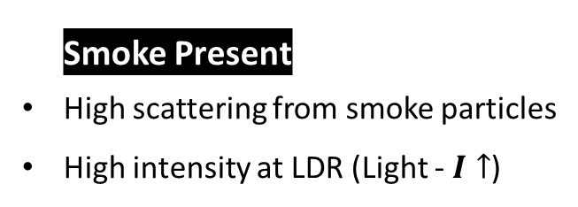
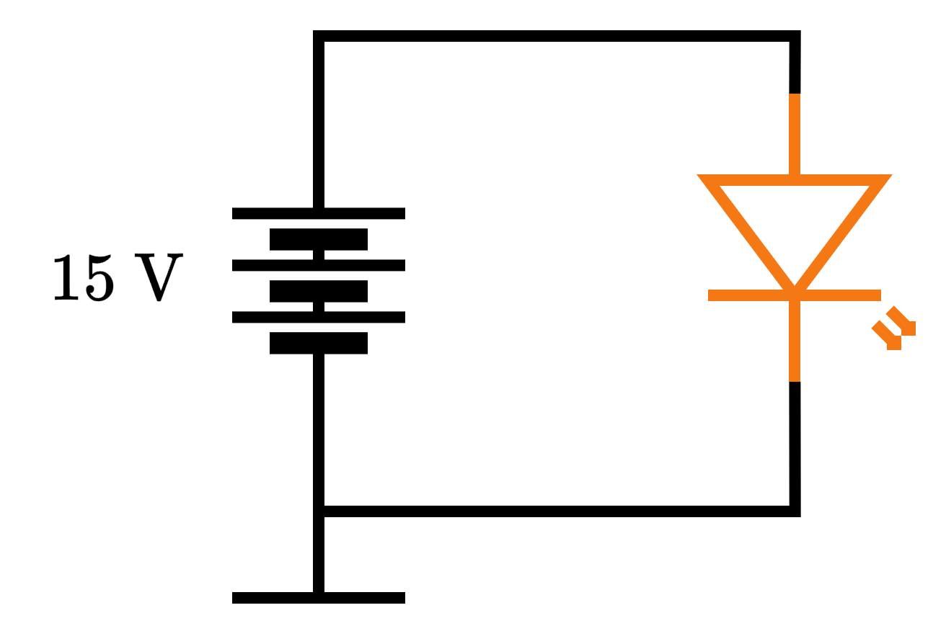

Smoke Detector - Operation
Light from the LED is reflected off the smoke particles on to the photoconductor –
Light Dependent Resistor (LDR).
Voltage Divider
LDR @
Light is lost in the environment
LED Circuit

Slide 8
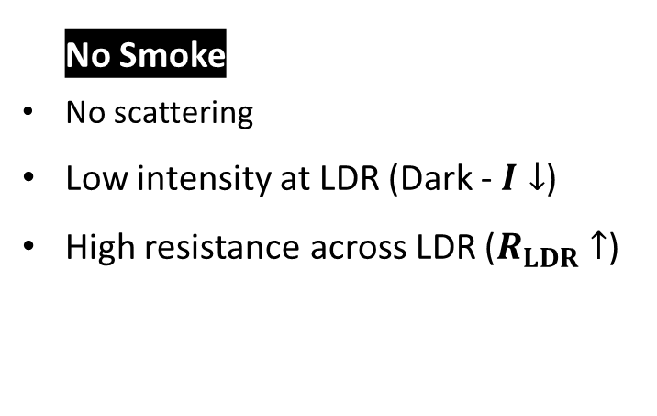
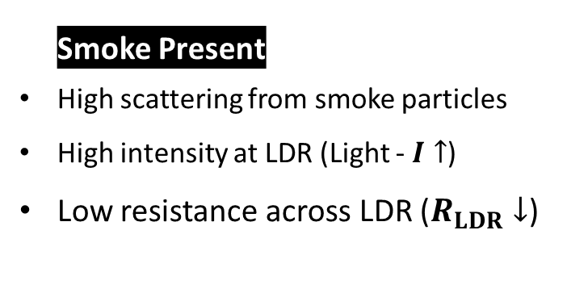
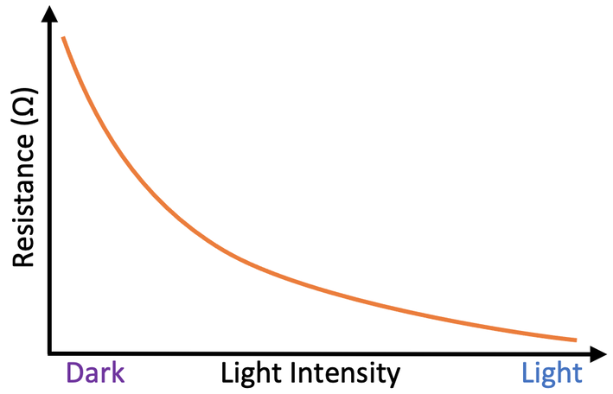
Smoke Detector - Operation
Voltage Divider
LDR @
Light is lost in the environment

Slide 9
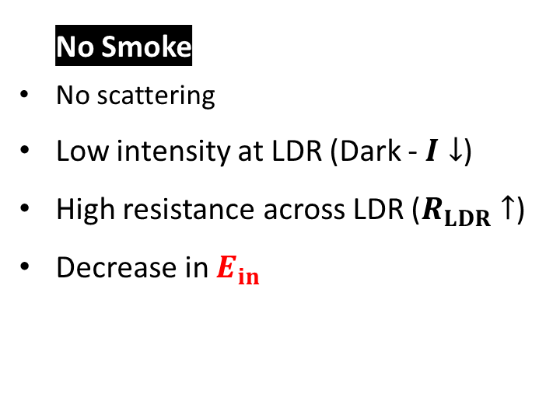
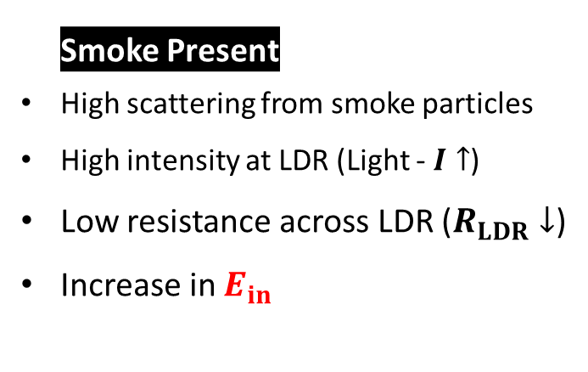
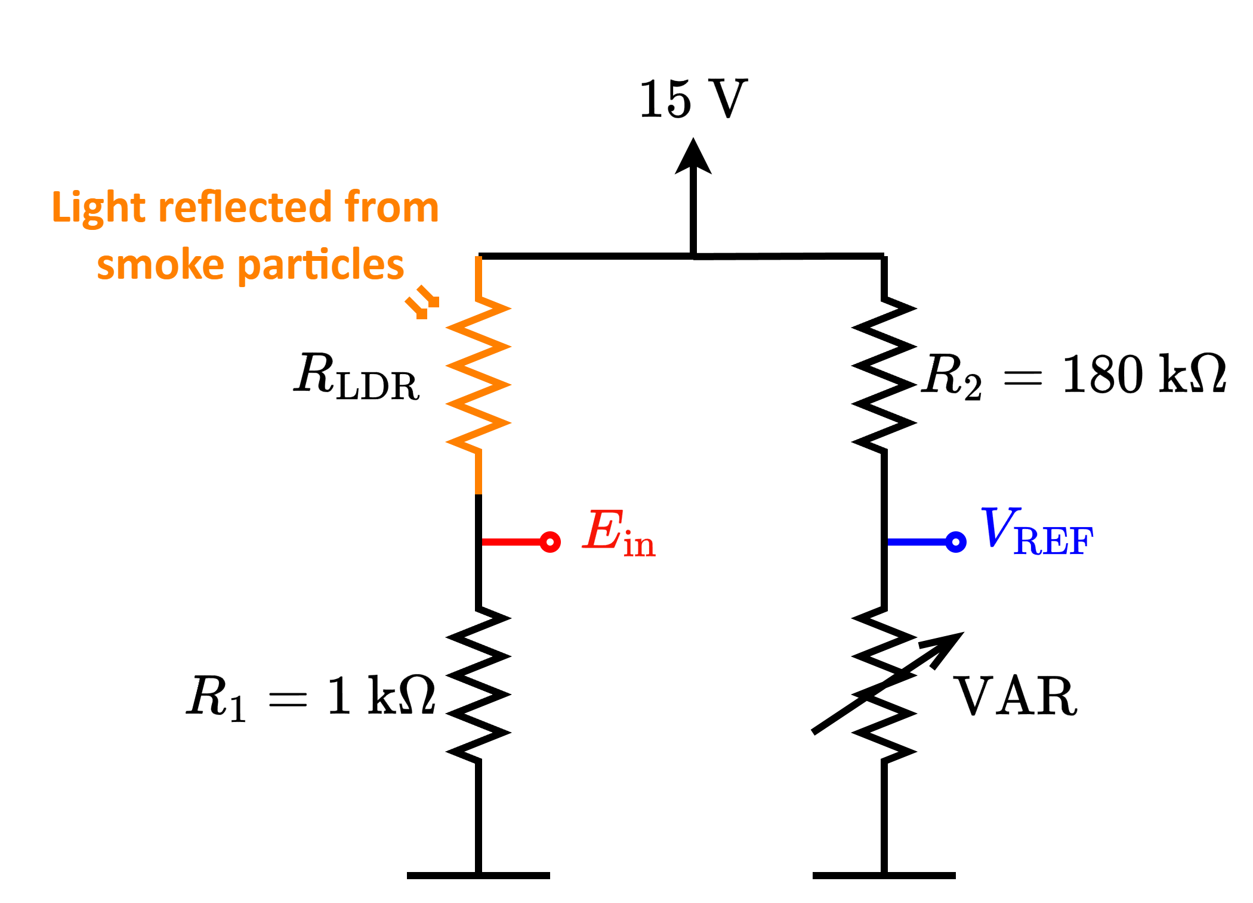
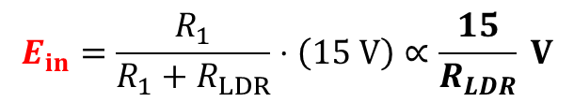
Smoke Detector - Operation
Voltage Divider

Slide 10
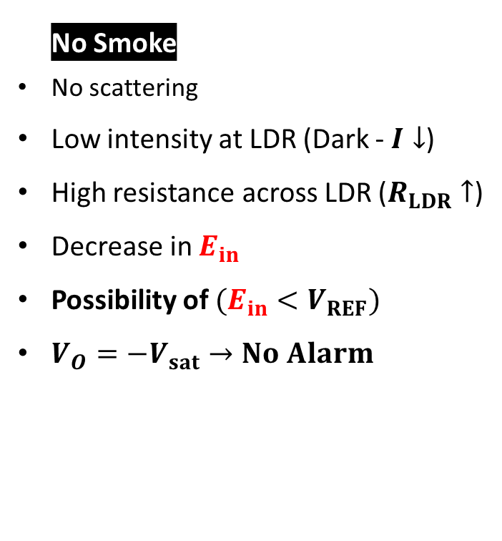
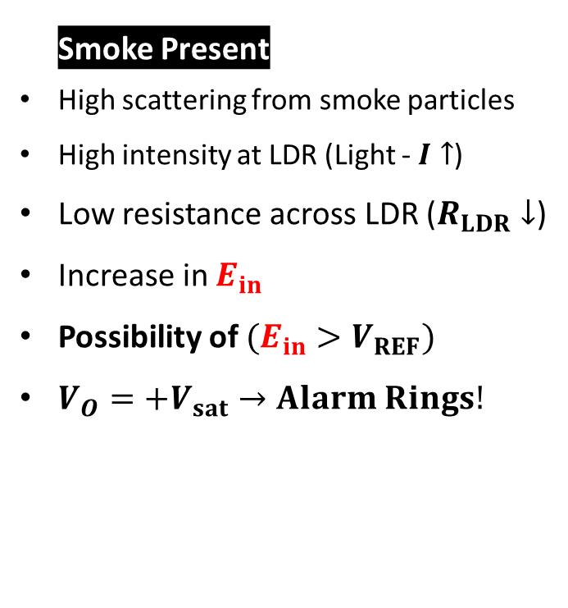
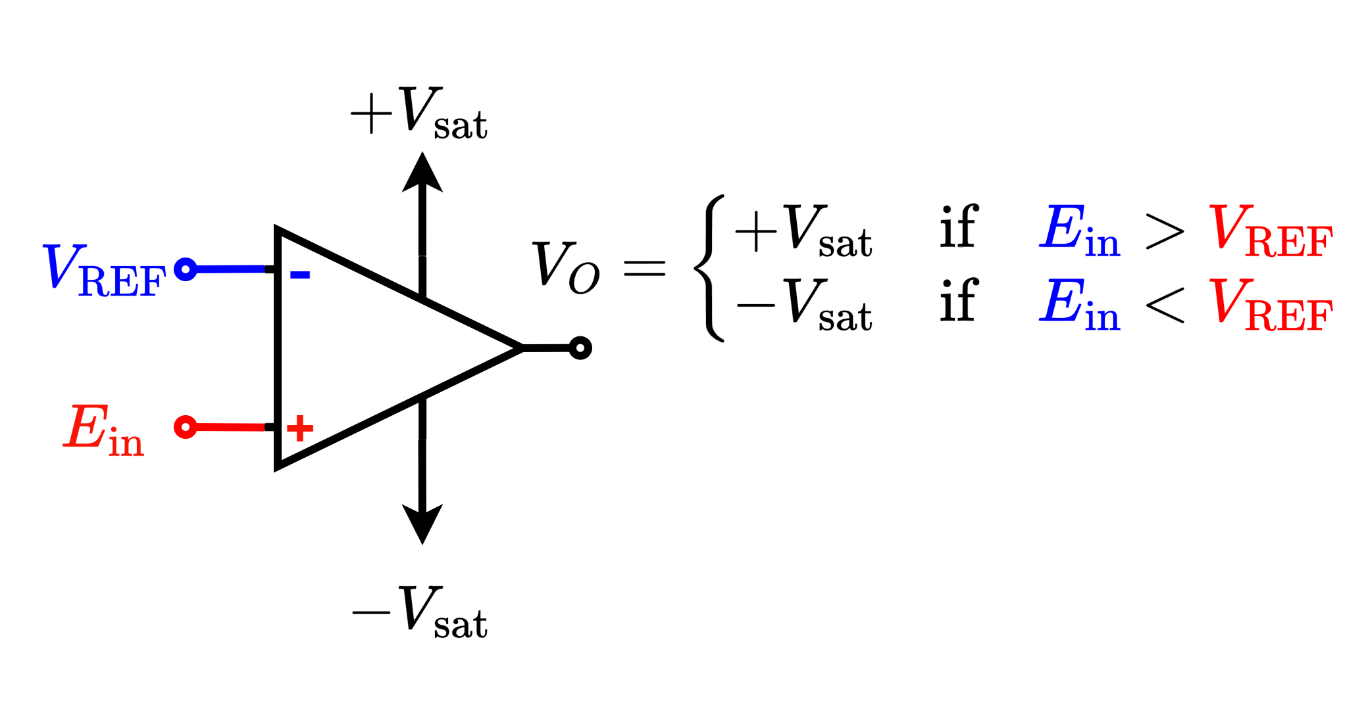
Smoke Detector - Operation
Non-inverting Op-Amp comparator

Slide 11




Smoke Detector - Operation
Non-inverting Op-Amp comparator
LED Circuit
Voltage Divider

Slide 12
Smoke Detector - Operation
Non-inverting Op-Amp comparator
LED Circuit
Voltage Divider

Slide 13


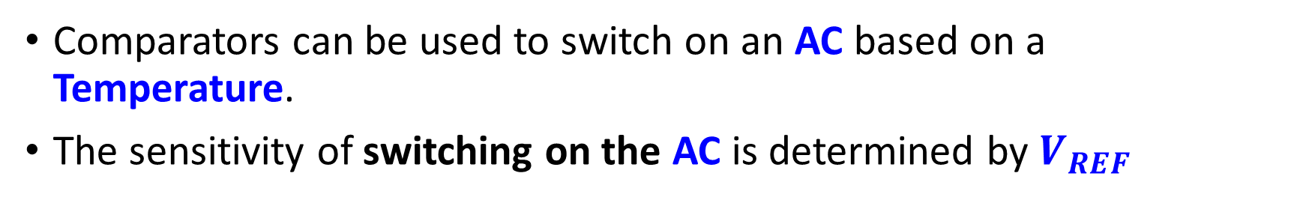
Comparator Application – Automatic AC
Sensitivity control
AC
Temperature Sensor
Temperature

Slide 14

Summary
Sensitivity control
Any Device
Physical Quantity
Sensor

Slide 15
Thank you

